Slide 1
Introduction to NORMAL LABOR
Hamdy Bakry Alqenawy, MD
Clinical Lecturer in Obstetrics and Gynecology Ain Shams University Faculty of Medicine

Slide 2
Outline
Definitions
Components of normal labor
Anatomy: maternal and fetal
Physiology of labor
Mechanism of normal labor
Stages of labor
Diagnosis of labor

Slide 3
Definitions
Labor
Repetitive uterine contractions of sufﬁcient frequency, strength, & duration to cause progressive cervical changes (effacement & dilatation).
Delivery
The birth of the baby, either vaginal or cesarean.
Normal delivery
1 | 2 | 3 | 4 | 5 | 6 | 7 | 8 | 9 | 10
Spontaneous-onset | vaginal delivery | of a single, | living, | mature, | vertex-presenting fetus | in a reasonable time, | requiring no intervention, | with no fetal | or maternal complications.
 |  |  |  |  |  |  | (other than episiotomy)

Slide 4
LABOR
Components
Passage the bony pelvis
Passenger the fetus
Powers uterine action, maternal expulsive efforts
Mechanism
What naturally happens
Management / Conduct
What we do

Slide 5
COMPONENTS OF LABOR
The passage
The passenger
The powers

Slide 6
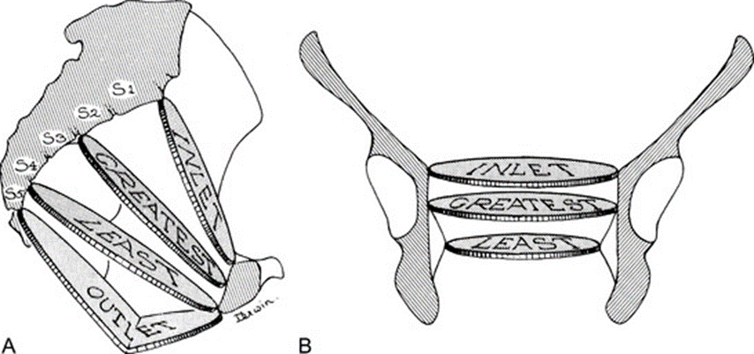
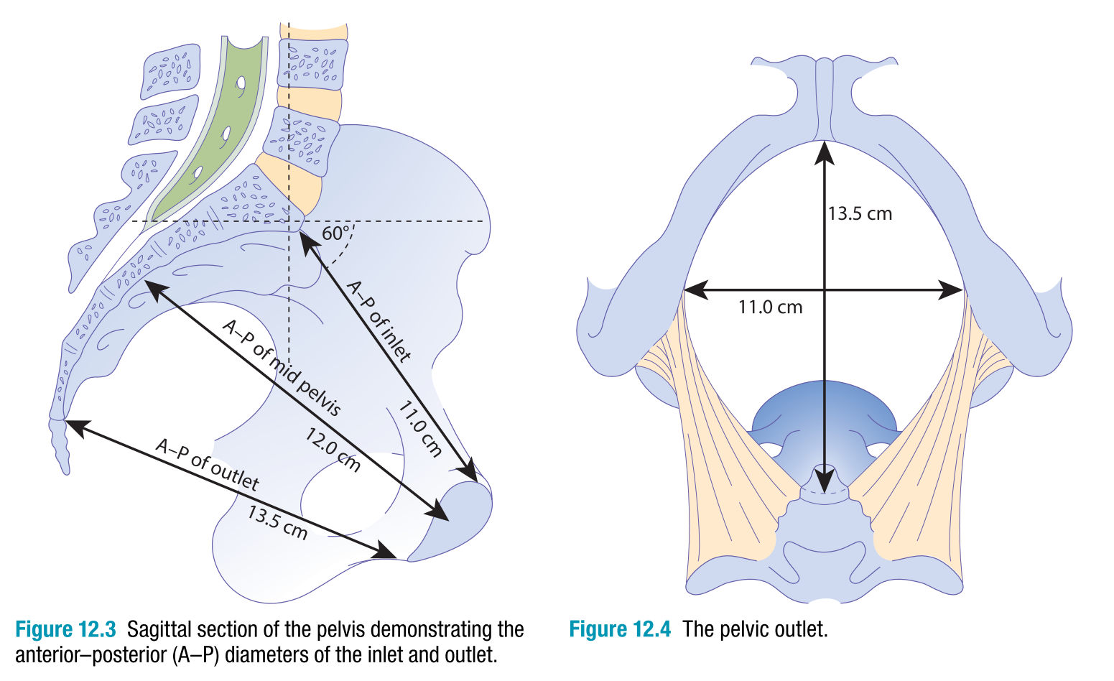
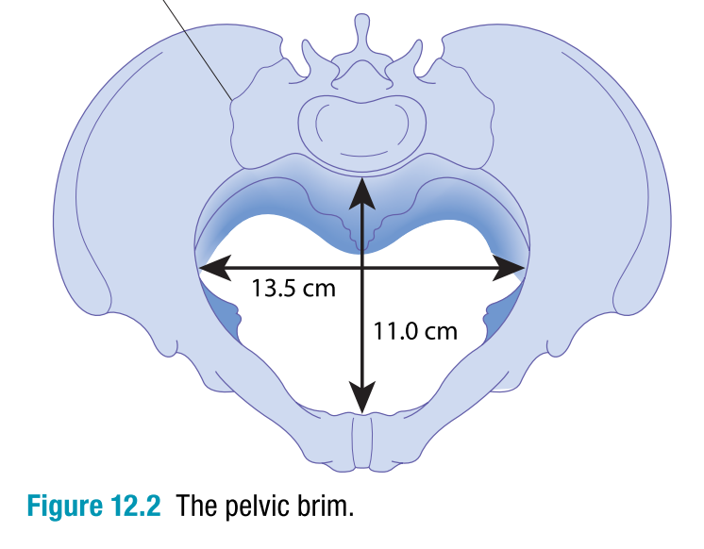
PASSAGE: the bony pelvis
The true pelvis is a bony canal that is divided into 3 parts:
Inlet
Engagement occurs when the widest diameters of the presenting part enter the inlet.
Cavity
It contains the widest plane of the true pelvis (at mid-cavity) where internal rotation occurs.
Outlet
It contains the narrowest plane of the true pelvis.

Slide 7
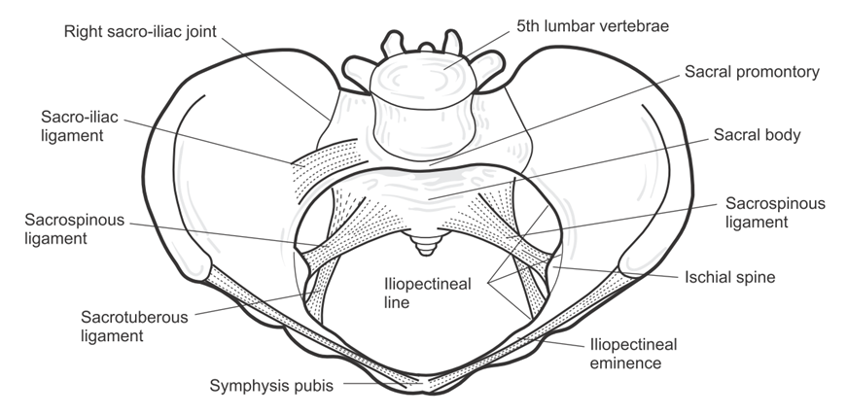
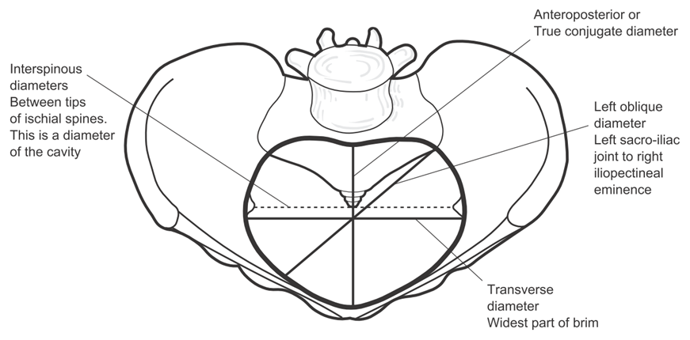
Inlet
The Plane of the Brim is bounded
anteriorly by the Pubis,
laterally by the Iliopectineal lines,
posteriorly by the Alae and Promontory of the Sacrum.
Diameters
AP
Transverse
Oblique

Slide 8
Inlet: antero-posterior diameters
Diameter | Posterior point | Anterior point | Length | Significance
Anatomical | Sacral promontory | upper border of SP | 11 cm | Classification of contracted pelvis
Obstetric |  | most bulging point on back of SP | 10.5 cm | Diameter negotiated in labor
Diagonal |  | lower border of SP | 12.5 cm | Can be measured by PV exam → diagonal – 1.5 = anatomical

Slide 9
Inlet: transverse diameters
Diameter | Points | Length | Significance
Anatomical | Between the farthest points on the brim (the widest transverse diameter) | 13 cm
Obstetric | Bisects the anatomical antero-posterior diameter | 12 cm | Diameter negotiated in labor Normal pelvis → both coincide Android pelvis → O<A and more anterior

Slide 10
Inlet: oblique diameters
Diameter | Posterior point | Anterior point | Length | Significance
Rt oblique | Rt sacro-iliac joint | Lt ilio-pectineal eminence | 12.5 cm | R > L → LOA more common than ROA
Lt oblique | Lt sacro-iliac joint | Rt ilio-pectineal eminence | 12 cm
Rt/Lt Sacro-cotyloid | Sacral promontory | Ilio-pectineal eminence of same side | 9.5 cm | Negotiated by BPD in OP engagement → delay

Slide 11
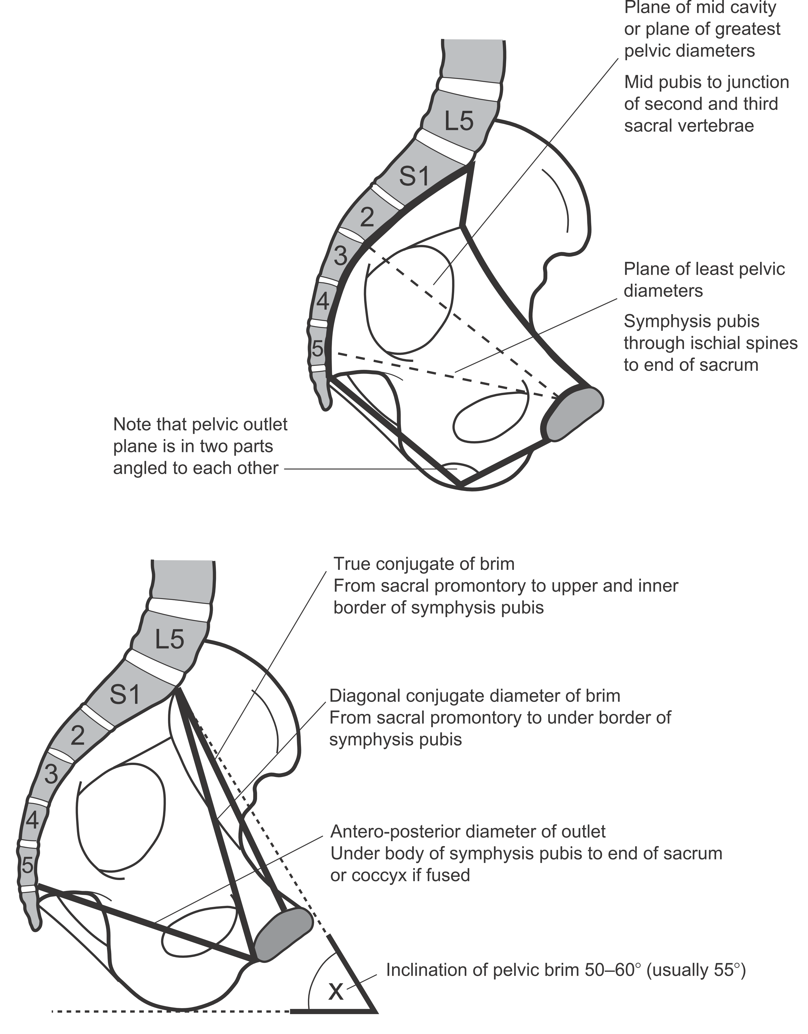
Cavity
The Pelvic Cavity is bounded
Above by the Plane of the Brim,
Below by the Plane of the Outlet,
Posteriorly by the Sacrum,
Laterally by the Sacrosciatic ligaments and Ischial bones and
Anteriorly by Obturator Foramina, Ascending Rami of Ischia and Pubis.

Slide 12
Cavity: diameters
Plane of greatest dimensions (12.5 cm in diameter, nearly rounded):
From the middle of the back of SP,
across center of acetabulum,
to the junction of 2nd & 3rd sacral pieces
Significance: the widest part of the pelvic cavity → internal rotation occurs when the widest diameters of the presenting part occupy this plane

Slide 13
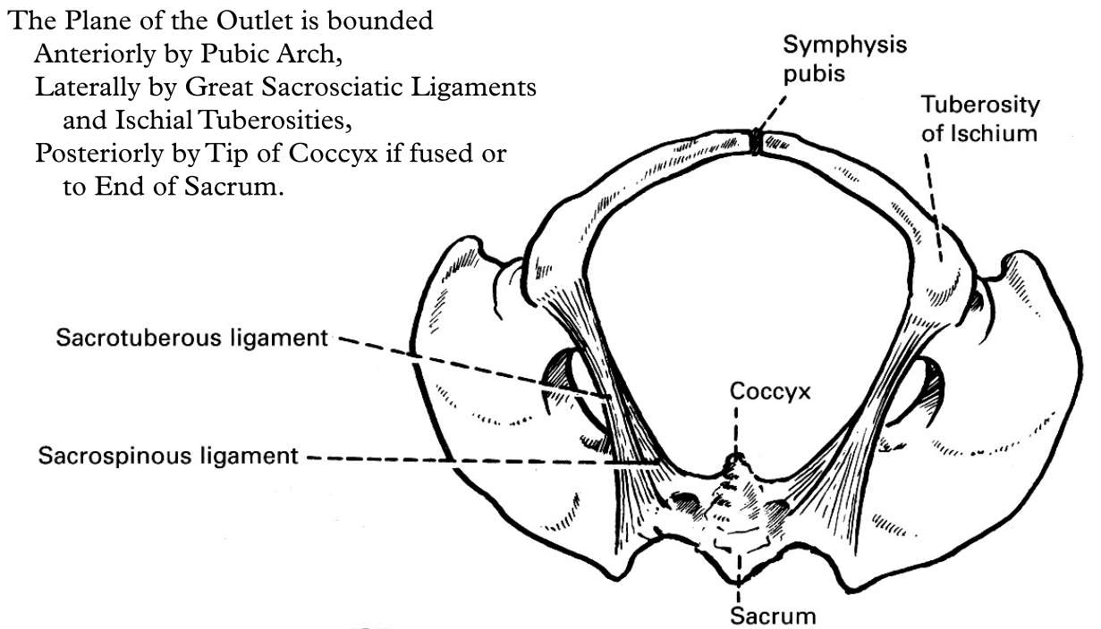
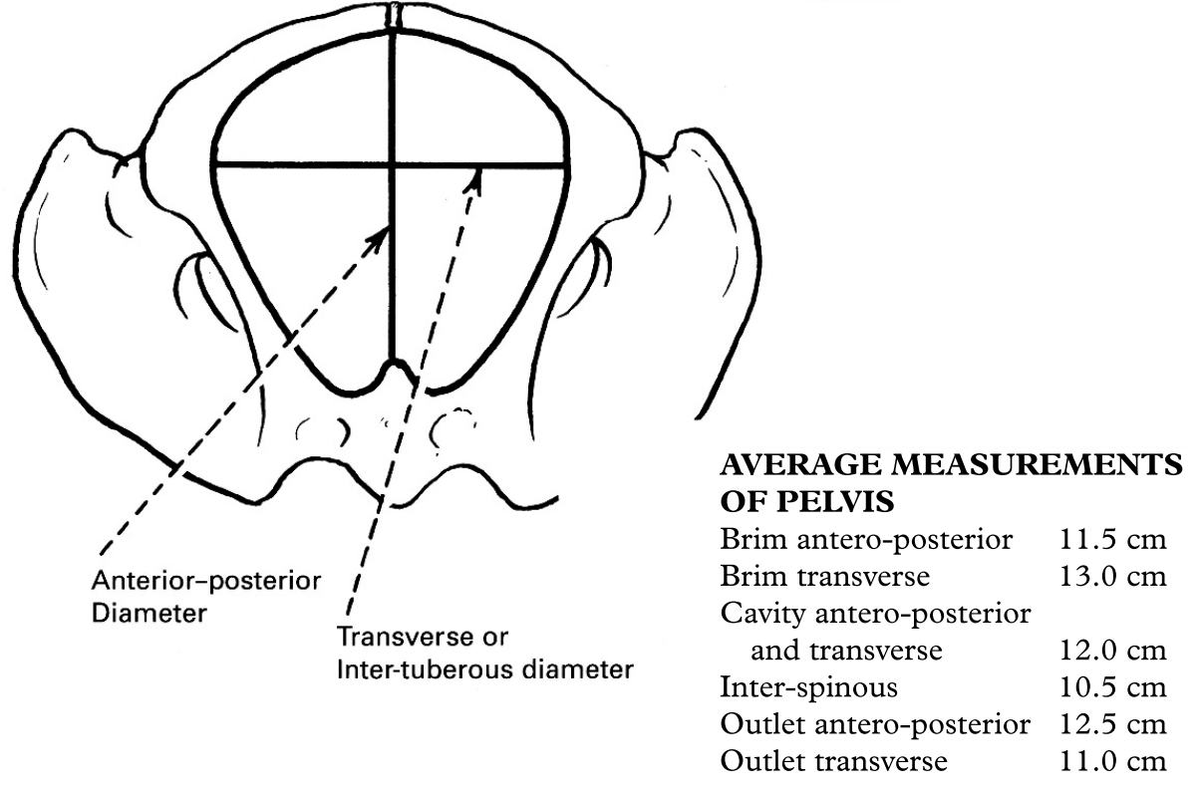
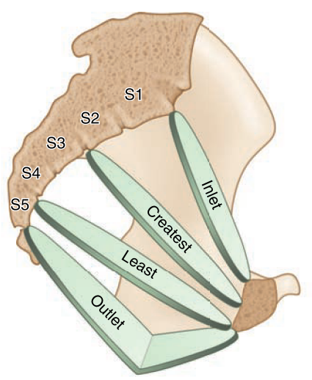
Outlet
Anatomical vs Obstetric
Anatomical outlet is a diamond-shaped plane, bounded
Anteriorly by pubic arch,
Laterally by great sacrosciatic ligaments and ischial tuberosities,
Posteriorly by tip of coccyx if fused or to end of sacrum.
Obstetric outlet is a segment, bounded
Above: plane of least pelvic dimensions (13×10.5 cm)
Below: plane of (anatomical) outlet (11×11 cm)

Slide 14
Outlet: diameters

Slide 15
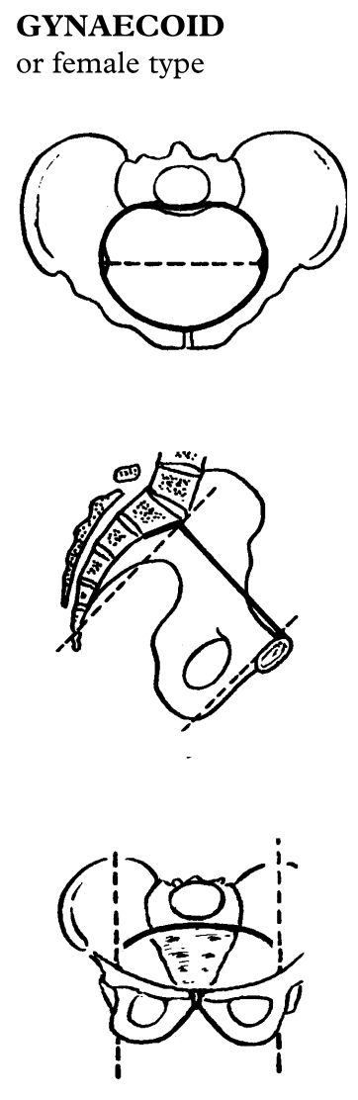
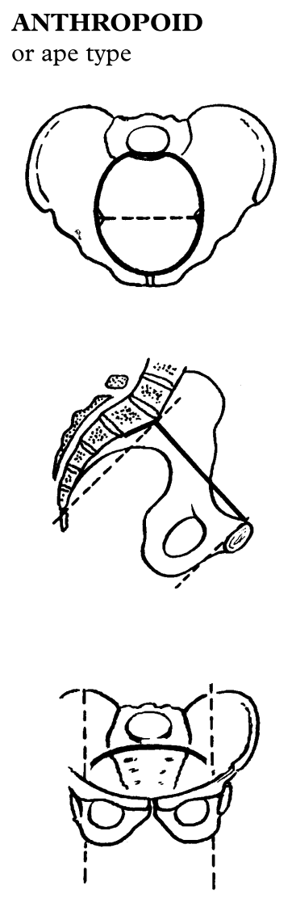
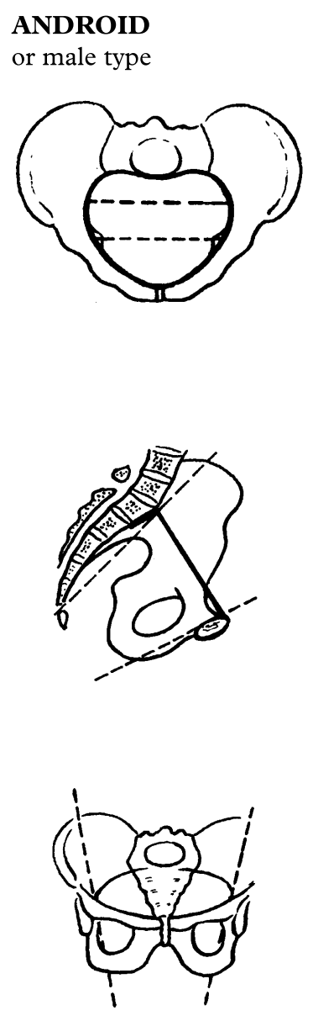
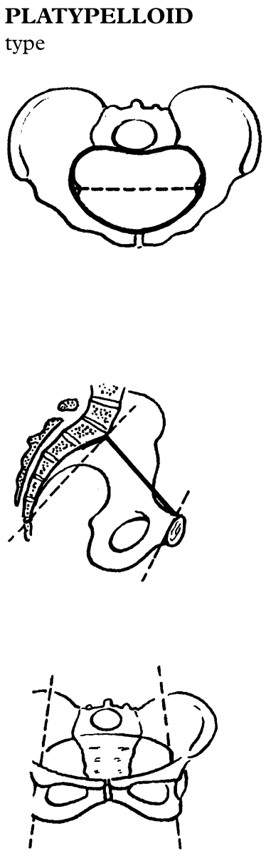
Types of the bony pelvis 4 types described: Gynecoid (50%), Anthropoid (25%), Android (20%), Platypelloid (5%). In many cases the pelvis is of mixed type.

Slide 16
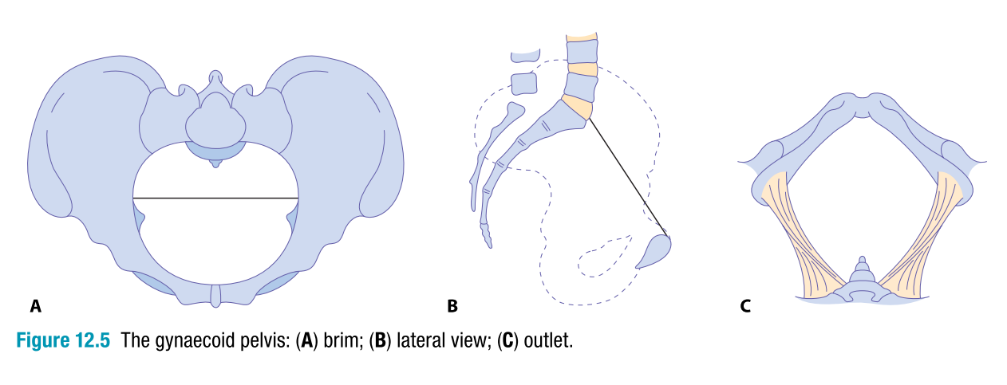
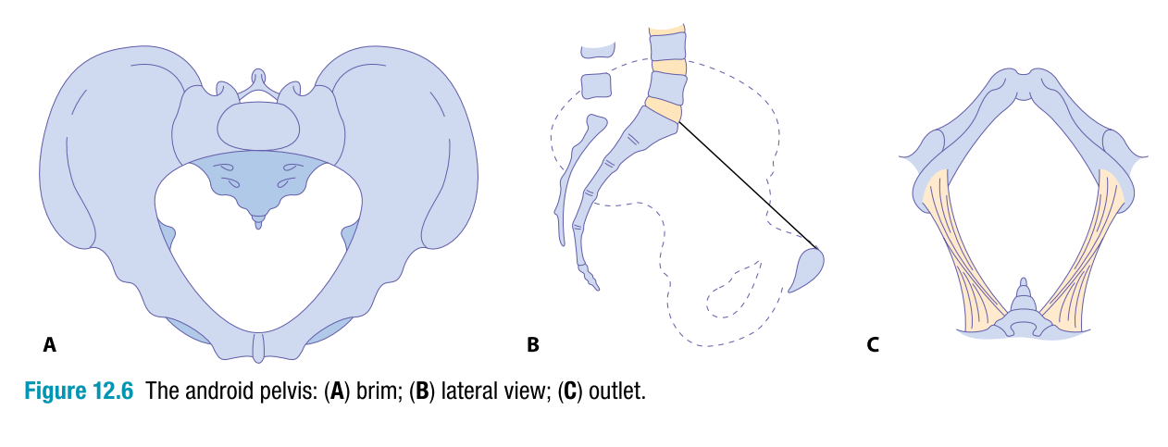
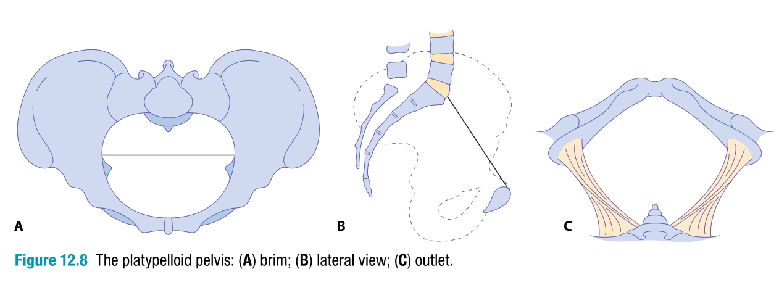
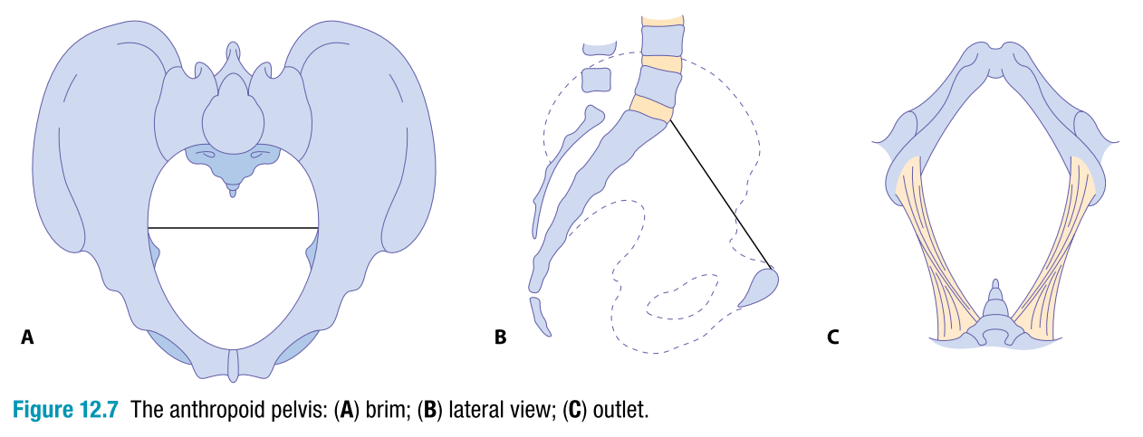
Types of the bony pelvis

Slide 17
PASSENGER: the fetus
Describing the fetus in space is according to:
Normally, the fetus expresses…
Lie
Attitude
Position
Longitudinal axis of the fetus & Longitudinal axis of the mother.
The lowermost part of the fetus, first entering the maternal pelvis.
The denominator (of the presenting part) to the maternal pelvis.
Relation between the fetal parts to each other (head & spine).
Presentation
Longitudinal lie
Vertex presentation
Occipito-anterior position
Full flexion attitude

Slide 18
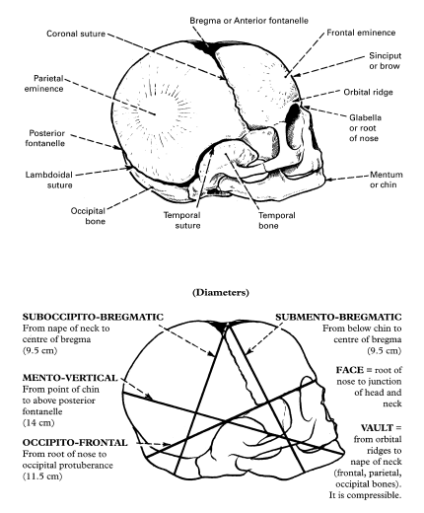
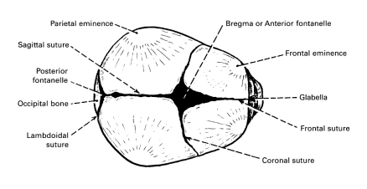
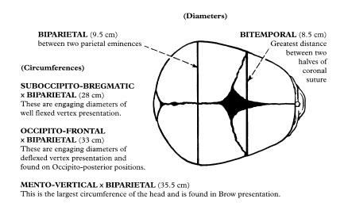


The Fetal Skull

Slide 19
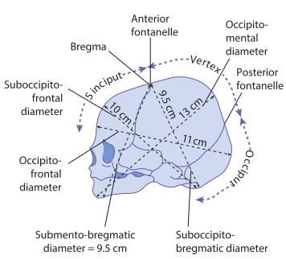




Denominators
Presentation |  | Denominator
Cephalic | Vertex | Occiput | ✔
 | Brow | Frontal bone | Malpresentation
 | Face | Chin (mentum)
Breech | Frank | Sacrum
 | Complete
 | Footling
Shoulder |  | Scapula
Compound
Presentation
Vertex |  | Malpresentation
Position
OA | Malposition

Slide 20
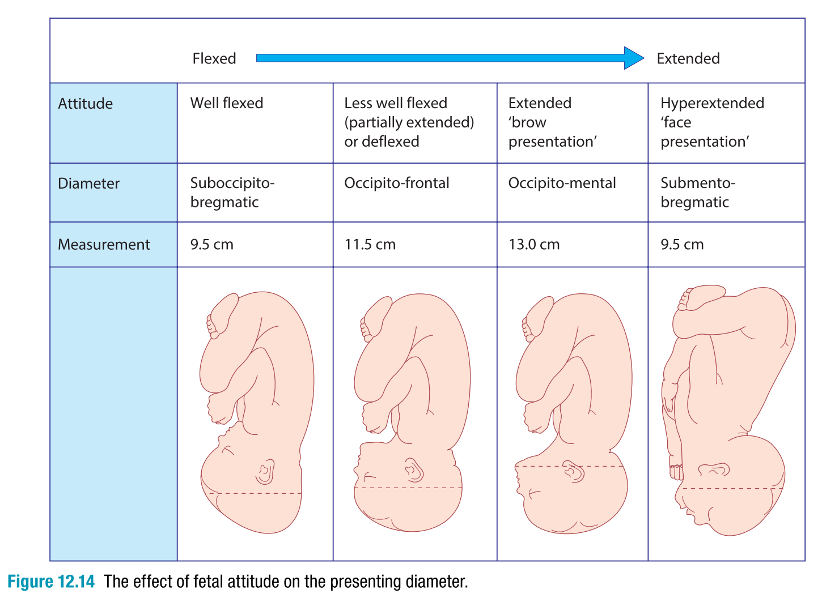

Slide 21
Position of the presenting part (the denominator in relation to the maternal pelvis, here seen from below)
Vertex | occipito
Brow | fronto
Face | mento
Breech | sacro
Shoulder | scapulo

Slide 22
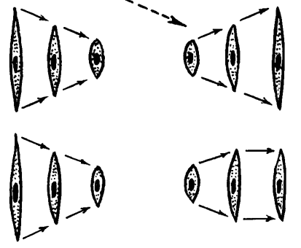
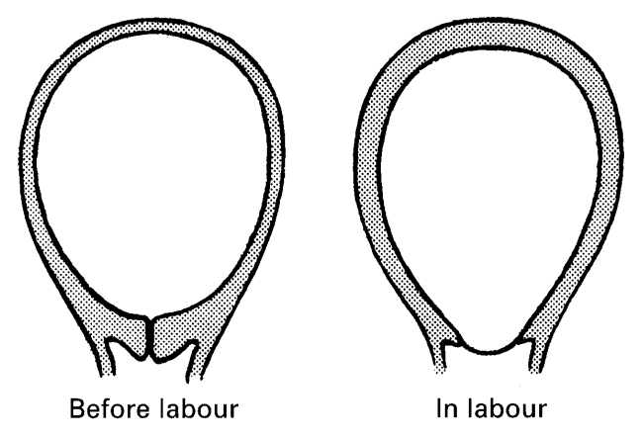
POWERS: uterine action
❶ Uterine contractions
Muscle contraction and retraction.
The uterine capacity is thus progressively reduced and the thickness of the uterine wall increased.
Each contraction is initiated at the right cornu, and spreads over the uterus.
The contractions show a gradient pattern, with fundal dominance and the lower uterine segment least active. This is the normal uterine polarity.
As labor progresses the contractions increase in frequency, strength and duration.

Slide 23
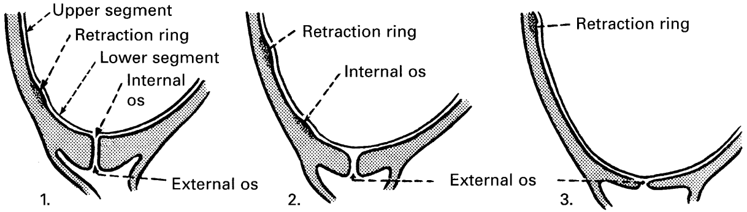
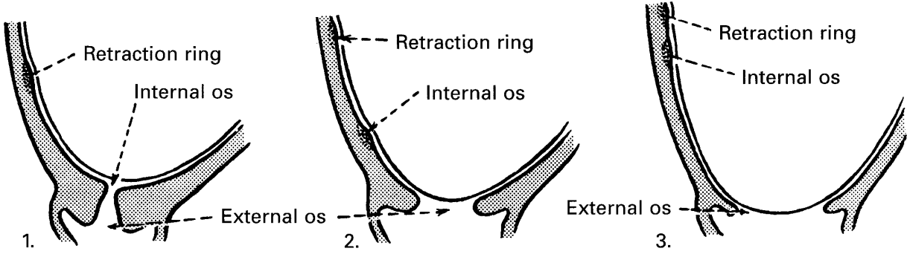
Progressive retraction of the upper segment muscle stretches and thins the lower segment and cause ❷ Cervical changes:
1. Effacement
2. Dilatation
Effacement is most striking in nulliparous women.
In multiparas, dilatation & effacement usually occur together.

Slide 24
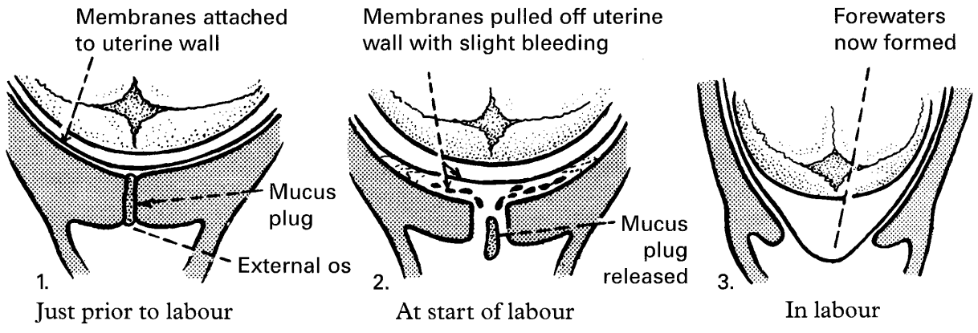
“Show” and formation of forewaters
Cervical changes loosen the membranes from the region of the internal os (with slight bleeding) and sets free the mucus plug. This constitutes the “show” and allows the formation of forewaters (the amniotic sac pushing against the cervix).

Slide 25
MECHANISM & STAGES OF LABOR

Slide 26

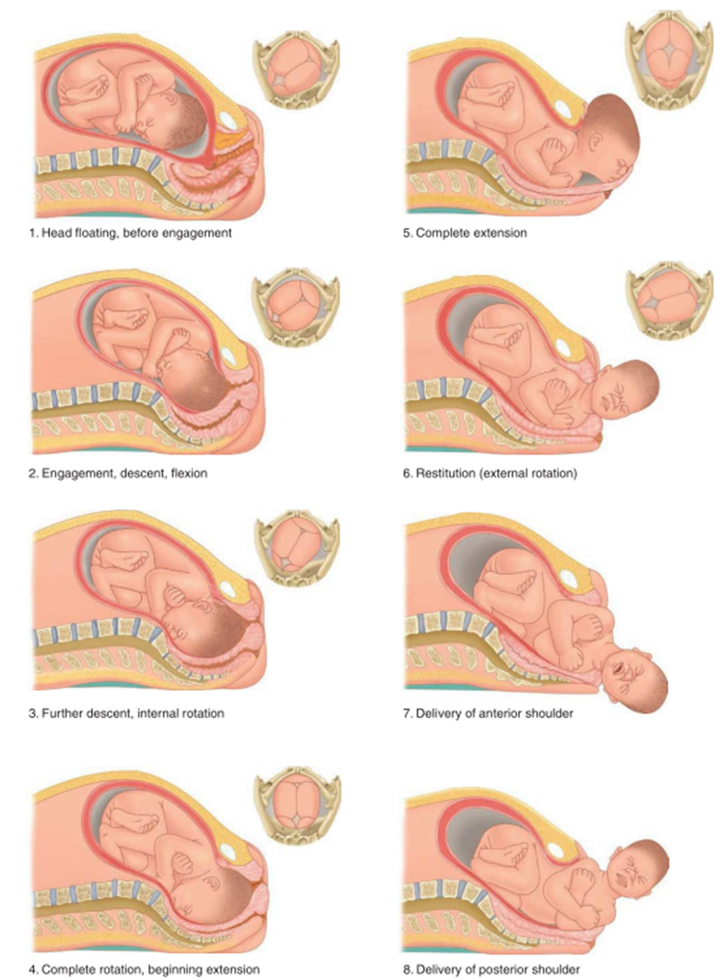
MECHANISM OF LABOR
Cardinal movements
A series of movements that the fetus makes as it passes through the birth canal.
Engagement of the presenting part (usually the head) into the maternal pelvic inlet.
Descent of the fetus down the birth canal.
Increased flexion of the head, bringing the chin to the chest.
Internal rotation of the head, so the occiput (the back of the head) is at the mother's pubis.
Extension of the head, pushing the occiput out first.
Restitution: The head rotates back to its original position, so the face is at the mother's thigh.
External rotation of the head, so that the shoulders are aligned with the mother's pelvis.
Delivery of the shoulders and Expulsion.

Slide 27
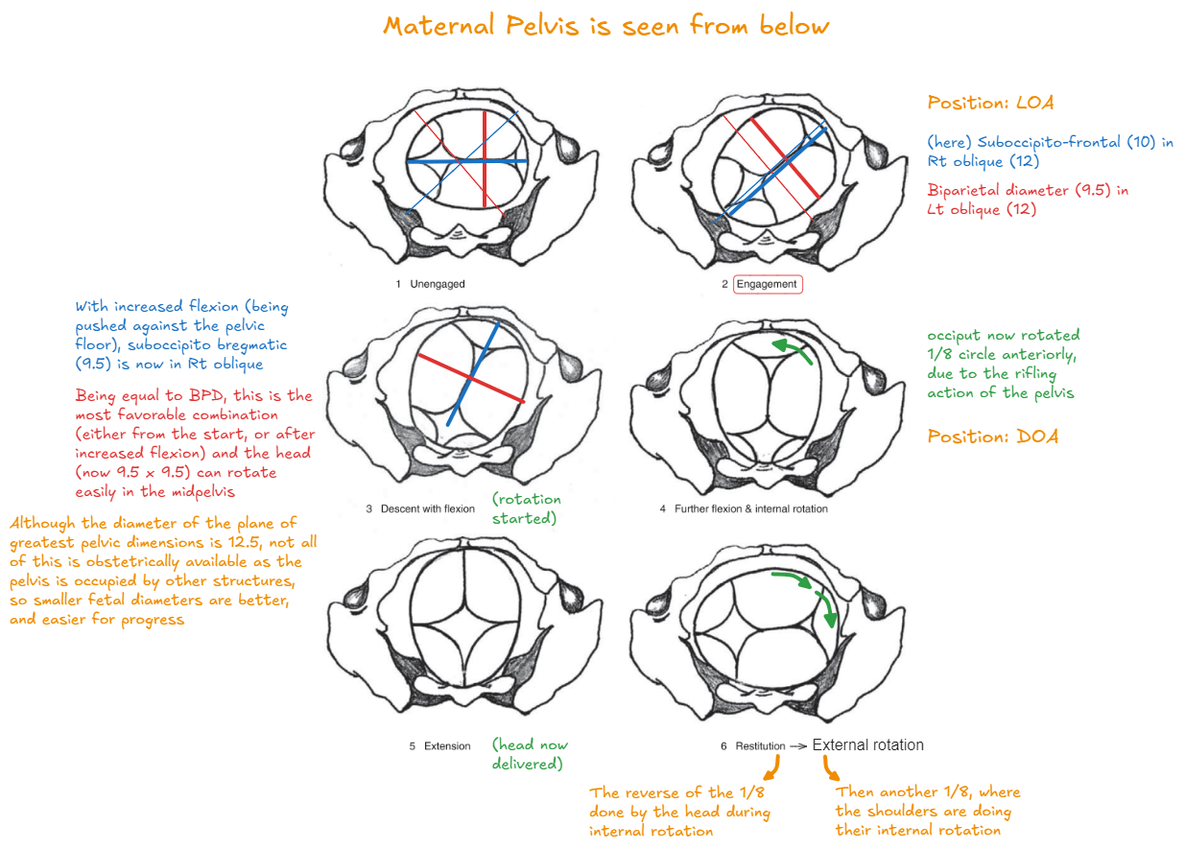
D | Engagement
E | Increased flexion
S | Internal rotation
C | Extension
E | Restitution
N | External rotation
T | Shoulders & Expulsion

Slide 28
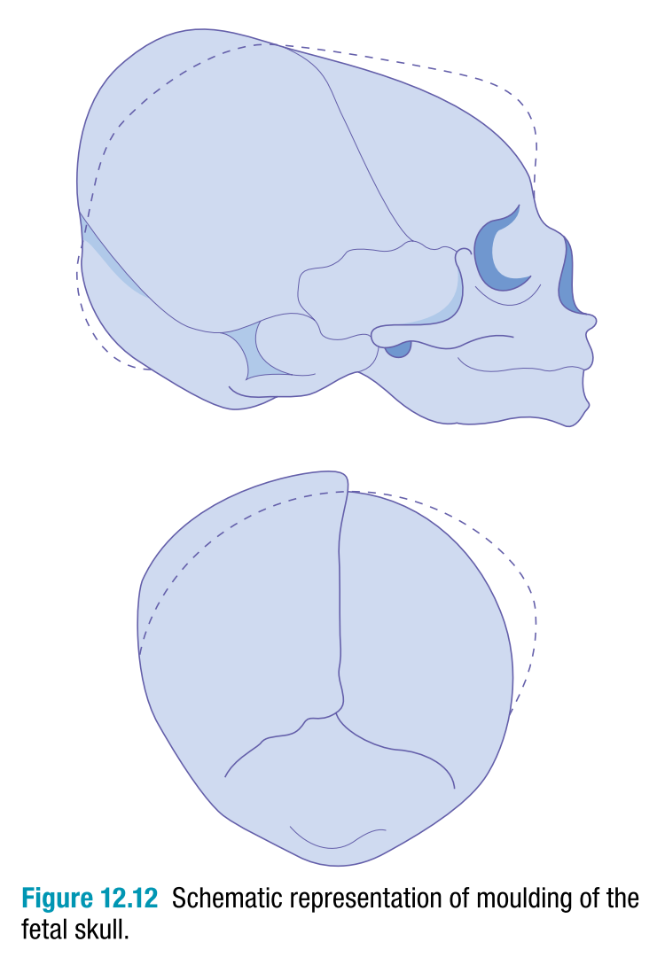
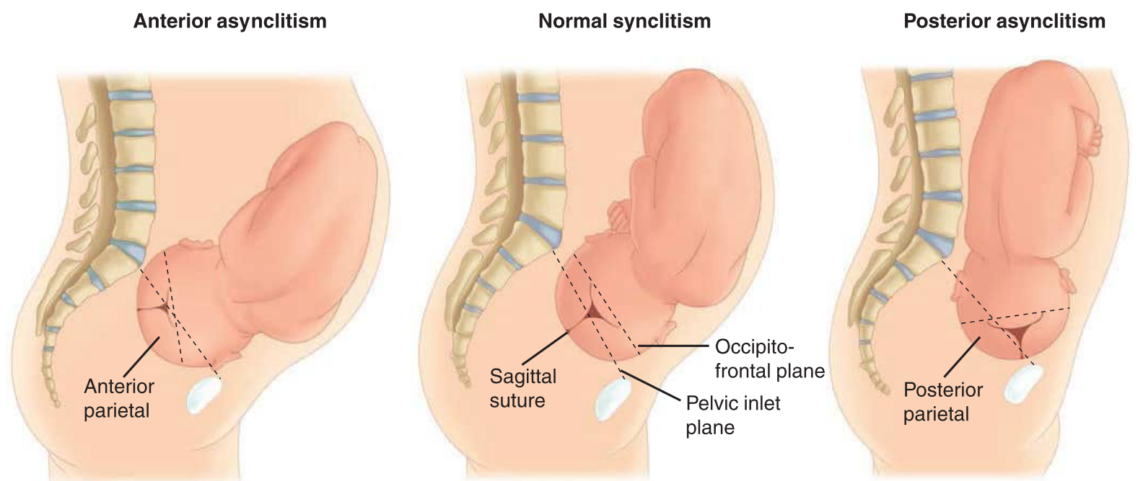

Slide 29
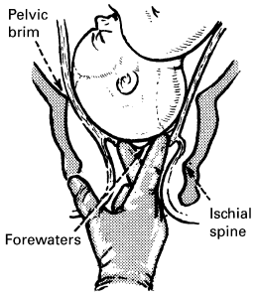
DIAGNOSIS OF LABOR
 | True labor | False labor
Regular contractions | Yes | No
“Show” | Yes | No
Progressive dilation & effacement of the cervix | Yes | No
Response to analgesia | No | Yes
Regular uterine contractions
Frequency: 3–5 in 10 minutes
Duration: each lasting 40–60 seconds
Amplitude:
“Show” from separation of the membranes at the lower pole causing bleeding which mixes with the cervical mucus plug.
Dilatation of the cervix + formation of forewaters.

Slide 30
STAGES OF LABOR
Labor is divided into 3 stages: (maximum of traditional durations provided)
 | NP 12-16 h; MP 6-8 h |  |  |  |  |  | NP 1-2 h; MP ½-1 h +1 h if epidural |  |  | < ½ h
 | NP 8 h; MP 4 h |  |  | NP 4-8 h; MP 2-4 h
Start of true labor pains |  |  | 4-6 cm dilated |  |  | Full cervical dilatation |  |  | Delivery of baby |  |  | Delivery of placenta
FIRST STAGE
SECOND STAGE
THIRD STAGE
Latent phase
Active phase

Slide 31
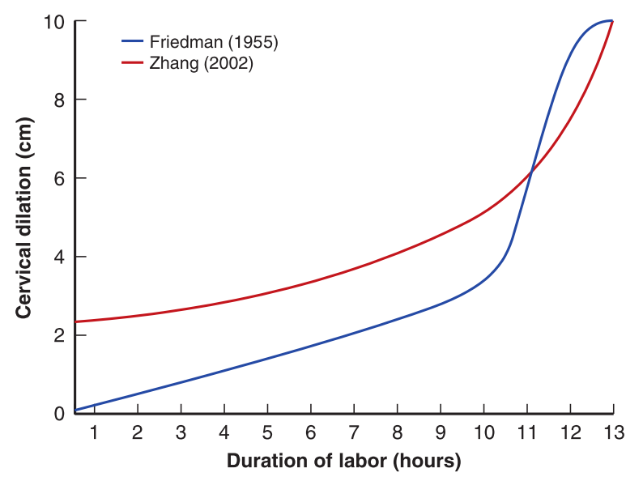
Normal labor pattern
Traditional vs contemporary cervical dilatation curves

Slide 32
PROGRESS IN LABOR
↑ strength, frequency and duration of uterine contractions assessed by:
Palpation
External abdominal transducer (tocodynamometer)
Intra-uterine catheter (MVU)
Progressive cervical changes estimated by vaginal examination
Descent of the presenting part recognized by:
Abdominal palpation
Vaginal examination

Slide 33
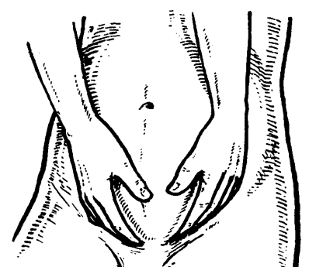
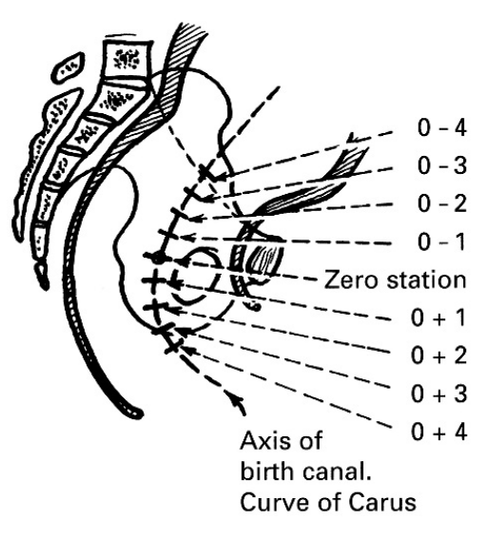
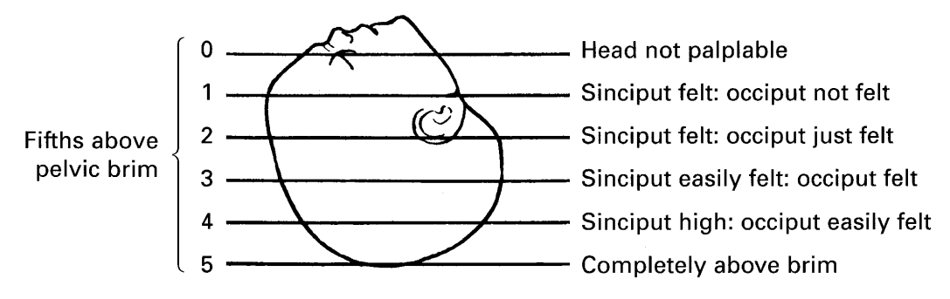
Descent during labor can be assessed by:
Abdominal palpation
Vaginal examination
How much of the head felt above the brim is expressed in “fifths.”
The ischial spines are the reference point to describe the station of the presenting part of the fetus (Zero station).
Estimations are in cm above or below zero
When lowermost point of the presenting part is at station 0 = just engaged.

Slide 34
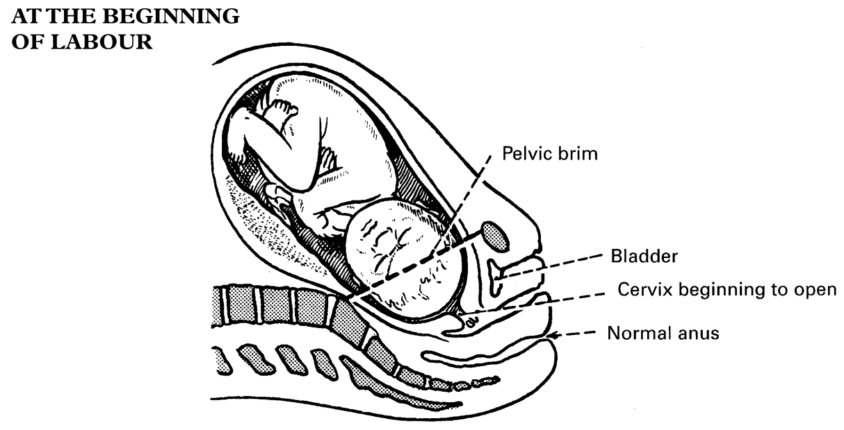
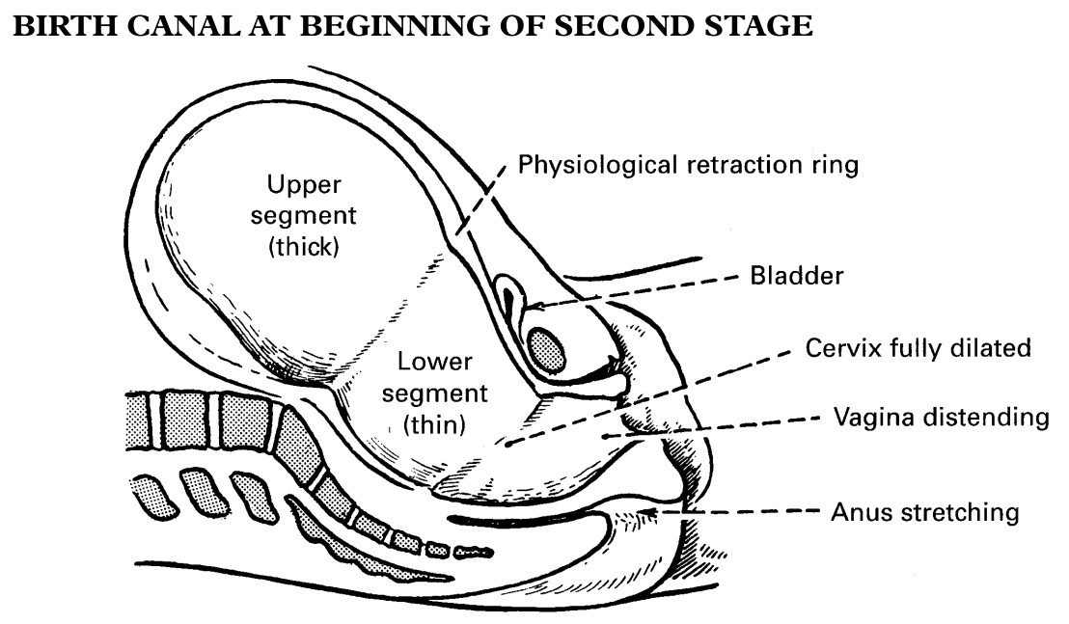

Slide 35
Summary
Labor is conventionally defined by 3 stages.
1st stage: progressive dilatation to full dilatation.
2nd stage: from full dilatation to birth of baby.
3rd stage: from birth of baby to placental expulsion.
± 4th stage: immediate postpartum period.
Criteria for active & latent phases of the 1st stage of labor have changed over the past 40 years.
Active phase commences at 5–6 cm, with
Normal dilatation occurring at 0.5 cm/h.
Progress in labor is determined by the assessment of 3 components (3 Ps):
Passage (awareness of adequacy of the pelvis);
Passenger (size and position of the fetus);
Power (strength of uterine contractions);
± Psyche (emotional state of the parturient).

Slide 36
THANK YOU

